Slide 1
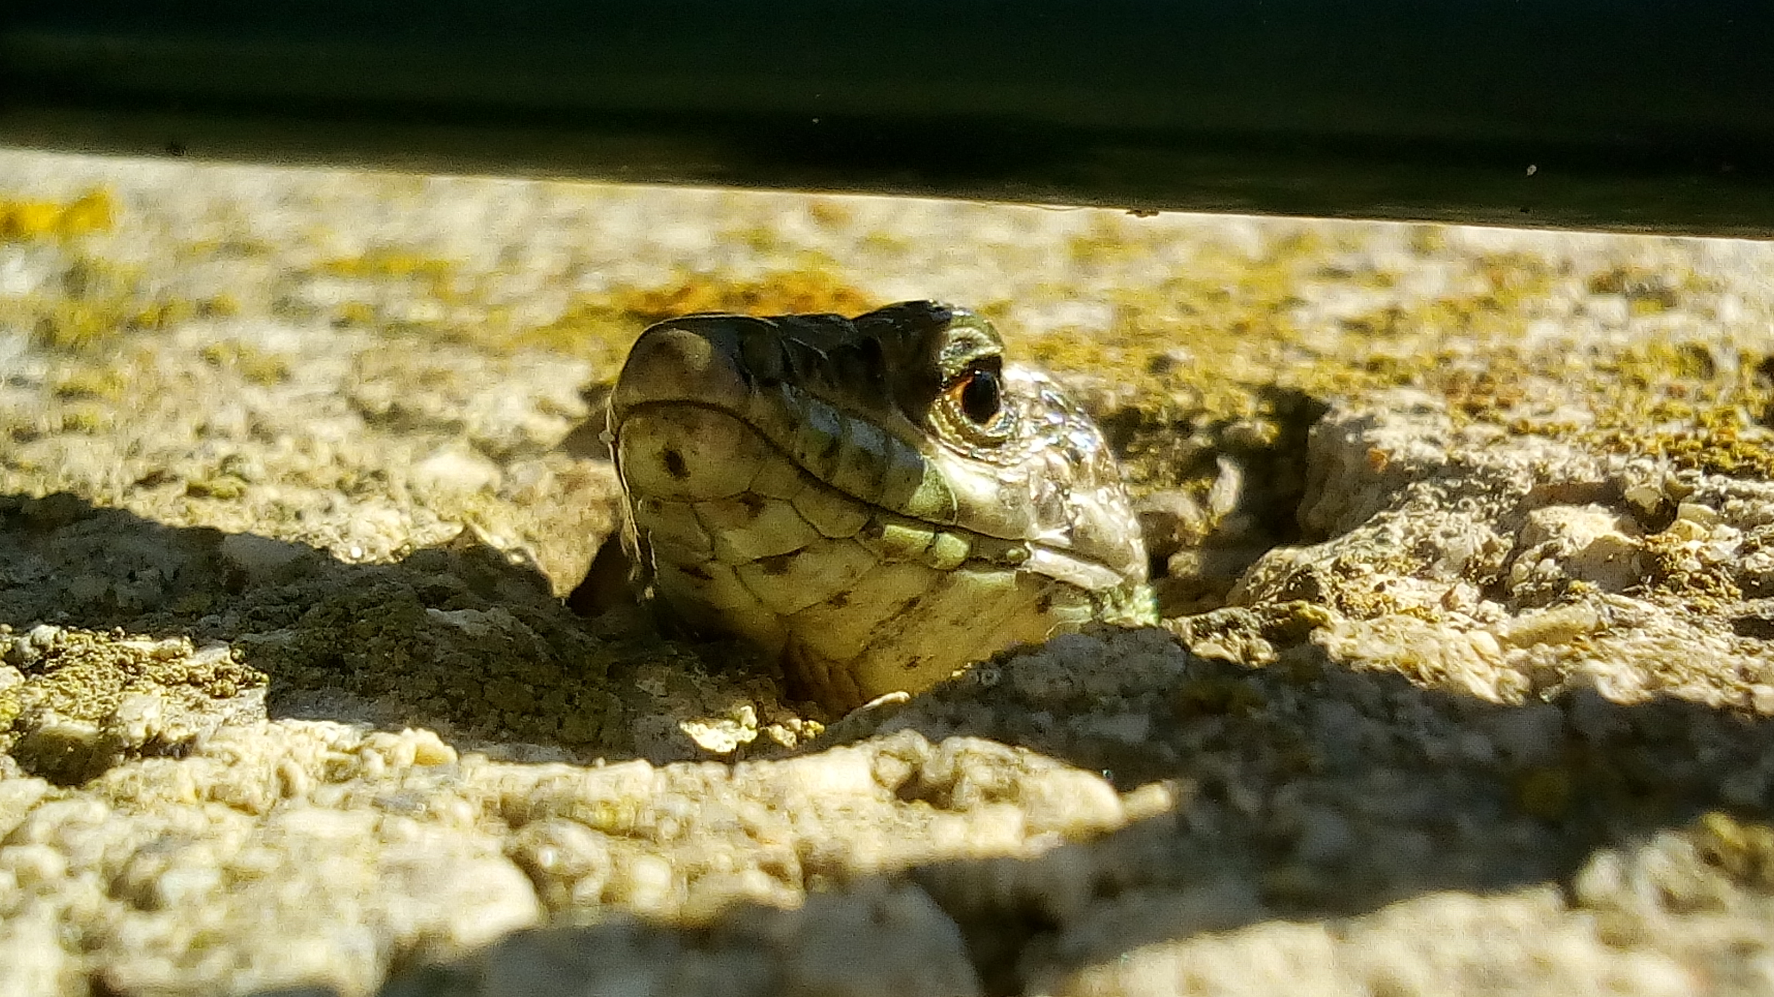

Tiny Life Saver Tools
How to use

Slide 2
Welcome to Tiny Life saver tools

Slide 3
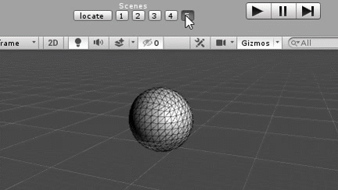
Mutli Scene Loading

